Slide 1
Political Power or Professional Power: An Analysis of Factors Influencing Chinese Foundation’s Private Donation
Zhaonan Zhu
2019.05.03

Slide 2
The characteristics of nonprofit sector
No universal equivalent in nonprofit sector.
Two clients in nonprofit sector.
What information could be used by donor to make their giving decision?
Value
Enterprise/Seller
Client/Customer
Price
Donor
Foundation
Beneficiary
Price
Value

Slide 3
Predictors of private donation to nonprofits
Performance
Government funding
Age,Size, Scope
Others?
Finiacial data
Ideally, donors want to give money to high-quality nonprofits;
However, information asymmetries result in contract failures (Hansmaan 1980; 1987; Krashinsky 1986;1997);
Donors rely instead on easily observable characteristics as proxies of performance(Jacobs and Marudas 2009);
US VS China.
Notes:
Chinese donors are not likely to use similar proxies of performance that US donors rely on.

Slide 4
The China’s state-society relationship
Authoritarian political regimes. (One party-CCP)
“Differentiated Controls”(Kang,2005);
“Contingent Symbiosis”(Spires,2011);
“Consultative Authoritarianism”(Teets,2013);
“Tacit Sanctioning Behavior”(Hsu,2014);
“Embedded Control”/ “Indirect Control”(Ni & Zhan, 2017; Wei, 2017).
In brief, the state/political power have great influence on nonprofits.

Slide 5
The professionalization of China’s nonprofit sector
China’s nonprofits have become more professionalized in recent years, however, there are few studies focusing on this process and its effect on the financial performance of nonprofits.
How to define professionalization in nonprofits?
Full-time staff or executive directors (e.g., Hwang and Powell 2009; Sua´rez 2011);Adoption of standard, professional decision-making practices (Grissom 2010)；Professionalization is an important management approach for achieving mission(As Sua´rez ,2011: 321) .
My opinion:
Professional administrative management;
Professional financial management ;
Professional program management .
Notes:
Others define its key feature as the adoption of standard, professional decision-making practices (Grissom 2010).
As Sua´rez (2011: 321) points out, ‘‘professionalization is an important management approach for achieving mission, yet the effects of professionalization on performance are not always clear.’’

Slide 6
Research questions
1. What factors could influence Chinese foundation’s private donation income?
2. Comparing political power and professional power, which factor have more impact on private donation?
3. Which aspect of professionalization have more impact of private donation?
Professional administrative management;
Professional financial management ;
Professional program management .

Slide 7
Operationalizing private donation
Dependent Variable(DV): Private Donation
The private donation is the amount of total private donations in a particular year (Unrestricted donation income + Restricted donation income)

Slide 8
Operationalizing political power
Political Power/ Government connections
Government founding (Wei, 2017)
Government officials are employees or board members ( the number of current government officials are employee or board members + the number of retired senior-level government officials who hold leadership positions in a foundation) (Wei, 2017 ;Ma, 2019)
State-linked foundations (SLFs); Non-state-linked foundations(NSFs)- Dummy variable (Ni & Zhan,2017;Wang, 2018; Ma, 2019)
The founding organization is governmental or quasi-governmental;
The initial endowment is from a governmental agency;
The current or retired government officials are employees or board members;
They share the same office address with supervising or sponsoring governmental or quasigovernmental Organizations.
Notes:
1. The founding organization is governmental or quasi-governmental;
2. The initial endowment is from a governmental agency;
3. The current or retired government officials are employees or board members;
4. They share the same office address with supervising or sponsoring governmental or quasigovernmental
Organizations.
(Johnson & Ni, 2015; Ni & Zhan, 2017;Wei, 2017; Ma, 2019)

Slide 9
Operationalizing professional power
Professional power
Professional administrative management
the number full-time employee
Professional financial management
Accountant qualification –dummy variable (Ni, Chen, Ding, & Wu, 2017)
Professional program management (my assumption)
Evaluation result (1A-5A)
Notes:
information disclosure policy

Slide 10
China’s foundation evaluation
In China, foundation registered for three years should be evaluated, because only the foundations which above 3A（we have 5 levels, from 1A to 5A）could get tax deduction status. But the evaluation mechanisms are very different in different province.
Foundations in China are very different from the US’s. More than 80% foundations in China conduct programs by themselves instead of supporting other NPOs. As a result, evaluators pay more attention on their program’s effectiveness, not just financial efficiency.
So, the evaluation result are good indicator reflect a foundation’s program professionalization.

Slide 11
Control Variables
Age: the time between each organization’s year of founding and the year of observation
Size: total assets
Board size :the number of board members
Scope: National level or Regional level
(Ni, Chen, Ding, & Wu,2015; Ni & Zhan, 2017; Nie, Liu, & Cheng, 2015; Wei, 2017; Ma,2019).
Notes:
Numerous previous studies also have used these control variables (e.g., Ni, Chen, Ding, & Wu,2015; Ni & Zhan, 2017; Nie, Liu, & Cheng, 2015; Wei, 2017).

Slide 12
Variables | Operationalization | Measure
DV: Private Donation | The amount of total private donations in a particular year | Unrestricted donation income + Restricted donation income
IV:Professional Power | Foundation evaluation scale | 5A, 4A, 3A,2A,1A
 | The number full-time employee | Number full-time employee
IV:Governemt Power | Government funding | Government subsidies(cash)
 | State-linked foundations | Dummy variable (0:NSF; 1: SLF)
 | Number of government officials serving as principals | Number of current government officials + Number of retired senior-level government officials
CV:Organizational Variables | Size | Total asset
 | Age of organization | The time between each organization’s year of founding and the year of observation
 | Board size | Number of board members
 | Scope | National level or Regional level
 | Fundraising type | Dummy variable (0: Non-public fundraising ; 1: Public fundraising)
Notes:
Fundraising type is dummy-coded as public and non-public fundraising. The public fundraising foundations can solicit donations publicly (e.g., advertising in shopping malls or subways),
while non-public fundraising foundations are allowed to solicit only through private channels and target specific individuals. This difference in fundraising capacity may influence private donations.
Moreover, public fundraising foundations are more likely to be connected with the government than non-public fundraising foundations. Therefore, the status of being public or non-public
may confound the relation between government funding and private donations

Slide 13
Data Source
RICF
RICF is the research infrastructure of Chinese foundations, a database for Chinese civil society studies (2013-2016).
Source link: https://github.com/ma-ji/RICF
Codebooks: https://github.com/ma-ji/RICF/blob/master/RICF%20Codebook.xlsx
Qun Wang’ s data (Wang_2018)
He coded 4231 Chinese foundation to clarify their state-link.
State-linked foundations (SLFs); Non-state-linked foundations(NSFs)
Notes:
Annual reports and audited financial reports .
Information disclosed by supervising government departments .
Information disclosed by the China Foundation Database (http://chinafoundation.org.cn; an information-disclosing platform supervised by the Civil Organization Administration Bureau, closed in early 2015 for unknown reasons).
Information disclosed by the China Foundation Center (http://foundationcenter.org.cn; an information-disclosing platform run by a nonprofit organization) .
News from the foundation’s official website. The website snapshots are taken and stored under the “raw data” folder (see Data Records section below; the same for source #6).
News from credible magazines or websites

Slide 14
Data Validation
China Statistical Yearbook-The Number of Foundation(National Bureau of Statistics of China ) 2009-2017
http://data.stats.gov.cn/easyquery.htm?cn=C01
RICF- The Number of Foundation, 2013-2015

Slide 15
Dataset
In order to answer my question, I extracted variables and merged five data frameworks as following:
Basic information_2015
Financial_activities_2015
Cash flow_2015
Financial position_2015
Wang_2018

Slide 16
Letter Code | Meaning | Source
ricf_oid | Organization ID | RICF: Basic_2015
fa_dint | Total donation income | Count
ba_evl | Foundation evaluation scale | RICF: Basic_2015
ba_nfe | The number full-time employee | RICF: Basic_2015
cf_govc | Government funding | RICF:Cash flow_2015
sc_gongo | Is state-linked foundations | Wang_2018(self-coded)
ba_gvof | Number of government officials serving as principals | Count
fp_tt | Total liabilities and net assets | RICF: Financial Position
ba_age | Organization's age | Count
ba_bn | Number of board members | RICF: Basic_2015
sco_na | Scope: National level or Regional level | Wang_2018(self-coded)
ba_ntr | Fundraising type | RICF: Basic_2015

Slide 17
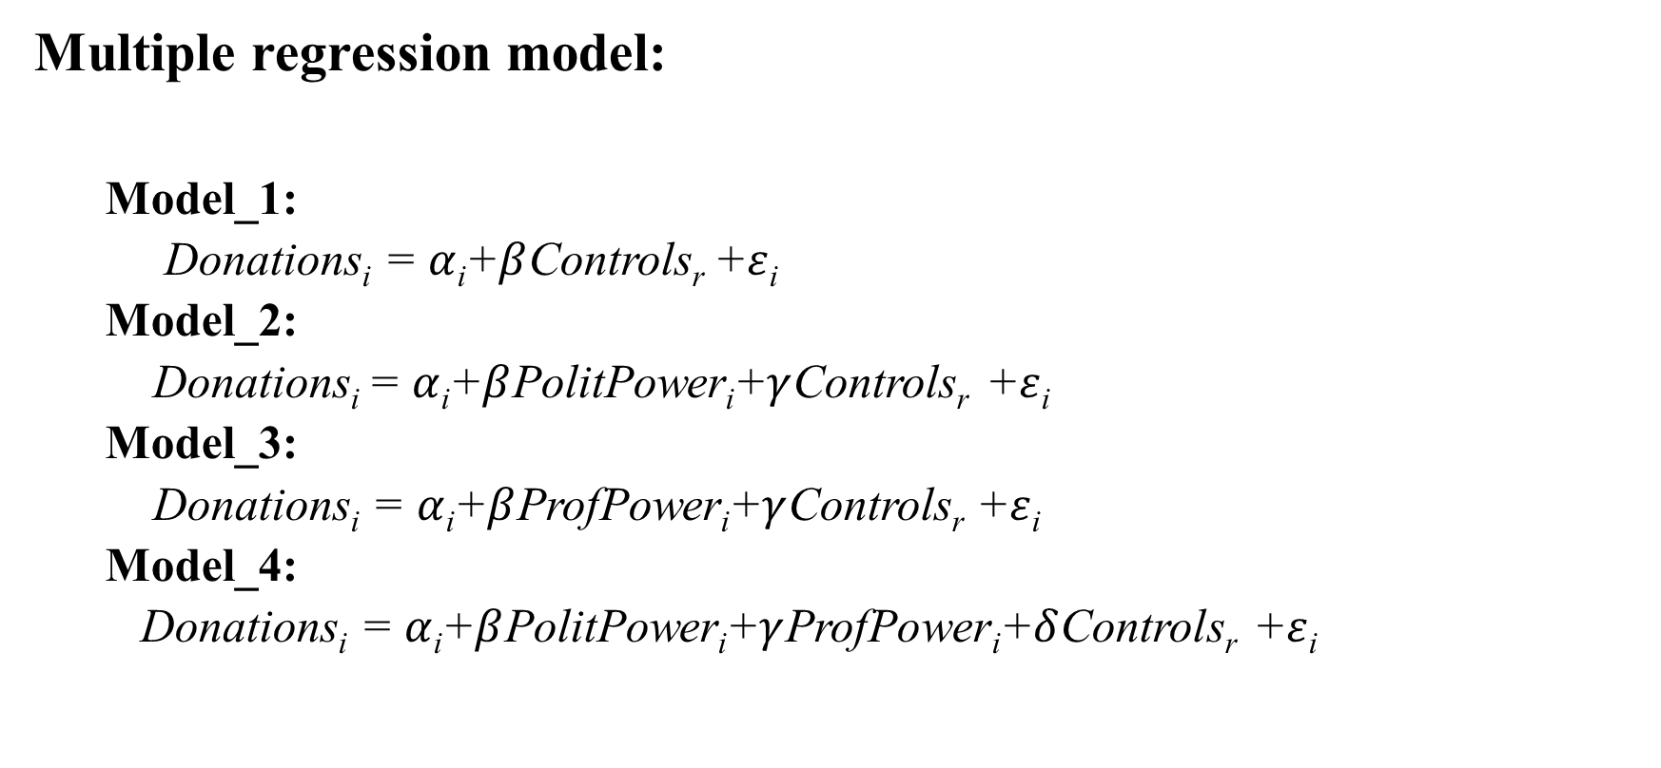
Method
Multiple regression model:
Model_1:
Donations_{i} = $α$_{i}+$β$Controls_{r} +$ε$_{i}
Model_2:
Donations_{i} = $α$_{i}+$β$PolitPower_{i}+$γ$Controls_{r} +$ε$_{i}
Model_3:
Donations_{i} = $α$_{i}+$β$ProfPower_{i}+$γ$Controls_{r} +$ε$_{i}
Model_4:
Donations_{i} = $α$_{i}+$β$PolitPower_{i}+$γ$ProfPower_{i}+$δ$Controls_{r} +$ε$_{i}

Slide 18
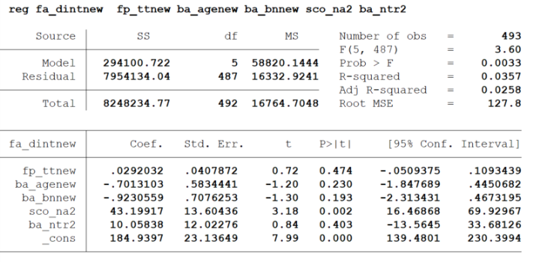
Results：model_1

Slide 19
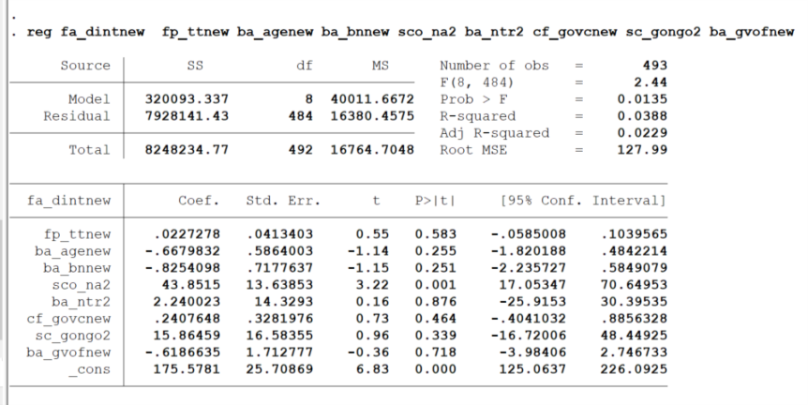
Results：model_2

Slide 20
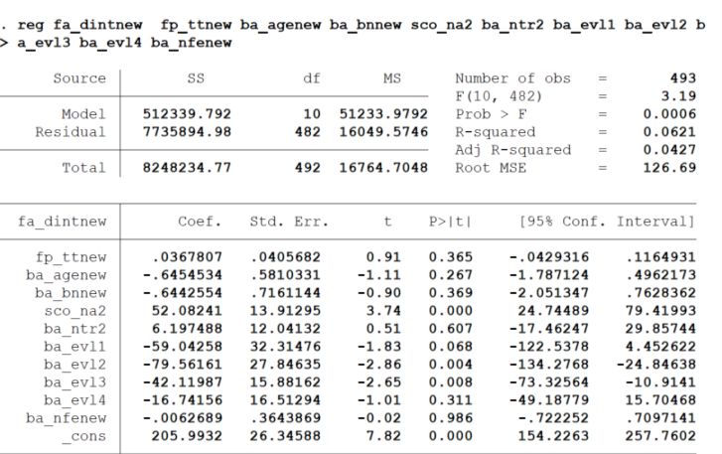
Results ：model_3

Slide 21
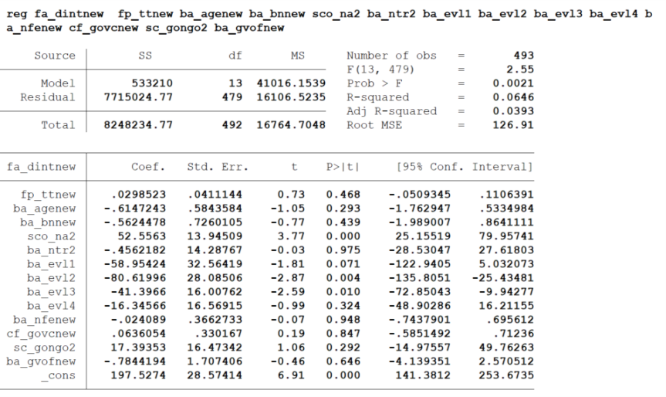
Results ：model_4

Slide 22
Conclusion and discussion
The empirical analysis in this article investigates the impact of political power and professional power on private donations in Chinese foundations in 2015.
Findings preliminarily indicate that, for foundations in China, political power and professional power both have statistically significant relationship with the amount of private donations an foundation receives.
However, professional power, especially program performance has more impact on private donation than political power.

Slide 23
Limitation/ Next step
Dataset: I only used RICF_2015, should add 2013-2016 data.
Supplement evaluation result data
National level foundation’s evaluation results: http://www.chinanpo.gov.cn/search/evaltindex.html
Bejing : http://mzj.beijing.gov.cn/news/root/tzgg/2018-03/126315.shtml
Other provinces: ???
Missing data and approximation strategy (eg: donation income)
Multicollinearity diagnostics
Log (Many variables are highly skewed, should be log transformed,
eg: government funding )
Longitudinal study to examine the change of political powder and professional powder.
Comparative study, eg: US-China.

Slide 24
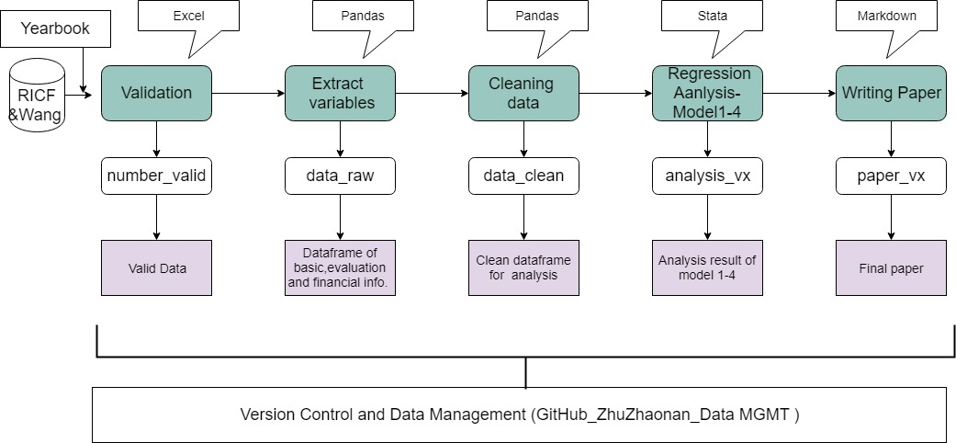
Work Flow

Slide 25
Data Management Plan
Folder organization
“Final”: final project and versions of all supporting files.
Data
Raw
Validation
Analysis
Process
Python_code
Stata_do
Output
Paper
https://github.com/ZhuZhaonan/DATA-MGMT

Slide 26
Data Management Plan
File naming
Final files be descriptively and concisely named.
Process files be named with the following convention: “YYYYMMDD_paper_vx.docx” (e.g. “20190301_paper_v2.docx”).
Version control
I keep versions up to date between my storage and github.
Reference manager
I use Zotero to organize my references and aid with citations.

Slide 27
Thanks!

